Slide 1
Open Robot in Gazebo and Rviz

Slide 2
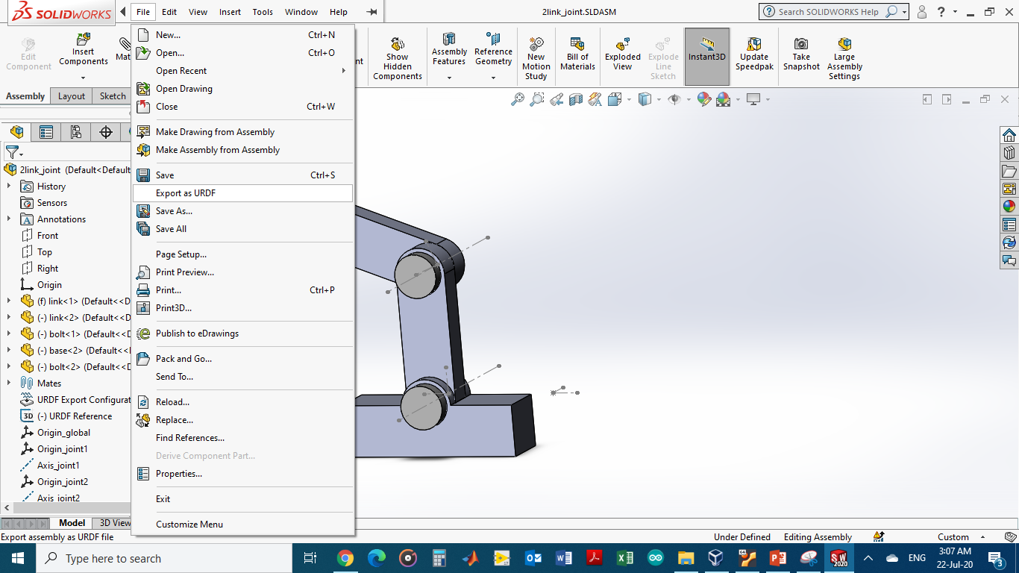
Export URDF files from solidworks
https://www.youtube.com/watch?v=cSeFLz0bCXw

Slide 3
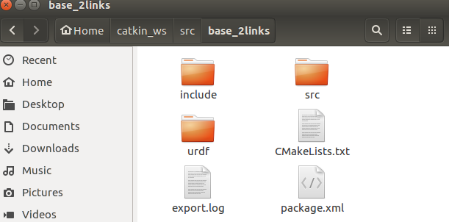
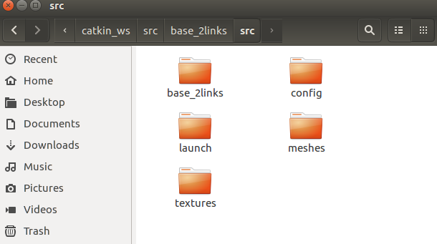
Transfer the urdf files to the ros workspace

Slide 4
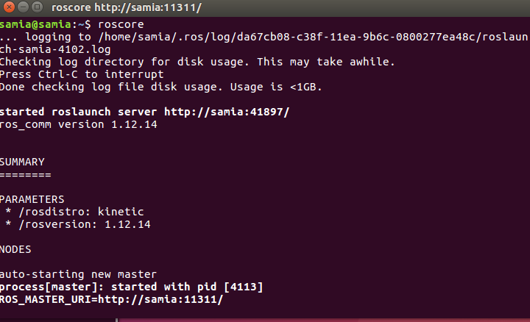
Run ros (roscore)

Slide 5
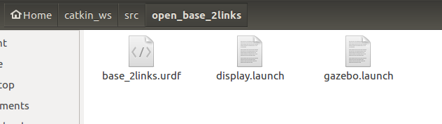
In new terminal change directory to project file in the ros workspace
In Rviz: (roslaunch display.launch)
In Gazebo : (roslaunch display.launch)

Slide 6
Error (I am missing the geometric properties of my robot) SOLVED
Change the mesh sections in the URDF file into the format below. (make sure the exact address of the .STL file is used)
<geometry>
<mesh
filename="file:///home/samia/catkin_ws/src/base_2links/src/meshes/base_link.STL" />
</geometry>
https://answers.ros.org/question/356918/urdf-model-not-appearing-in-rviz-nor-gazebo/

Slide 7
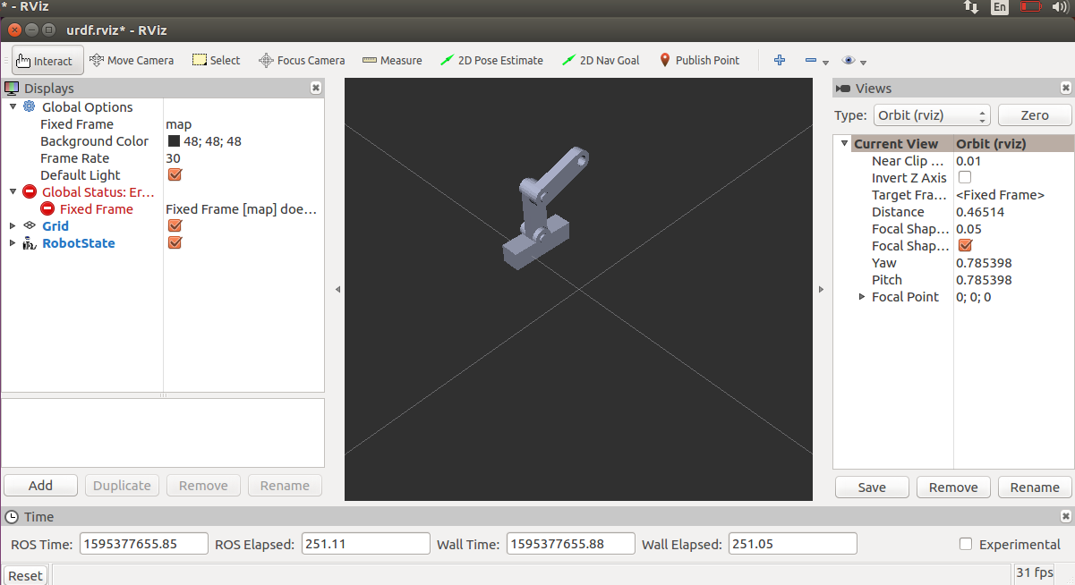
In Rviz
1) add
2) RobotState form moveit_ros_visualization
Moveit installation (sudo apt install ros-kinetic-moveit)

Slide 8
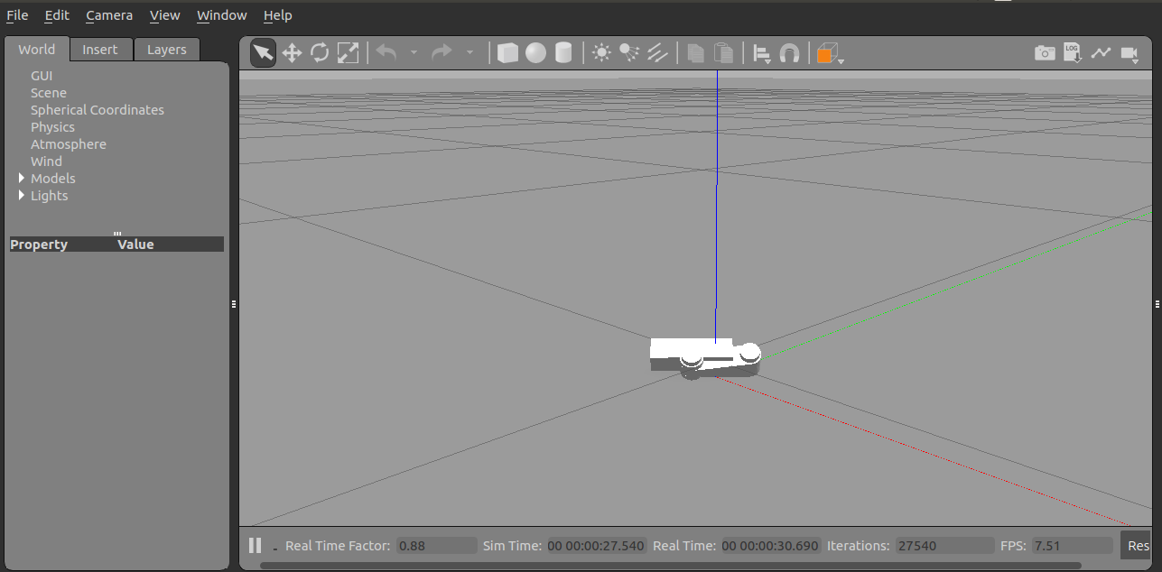
In Gazebo
Error: model collapsed ( I need to run the simulator in the paused mode )

